Slide 1

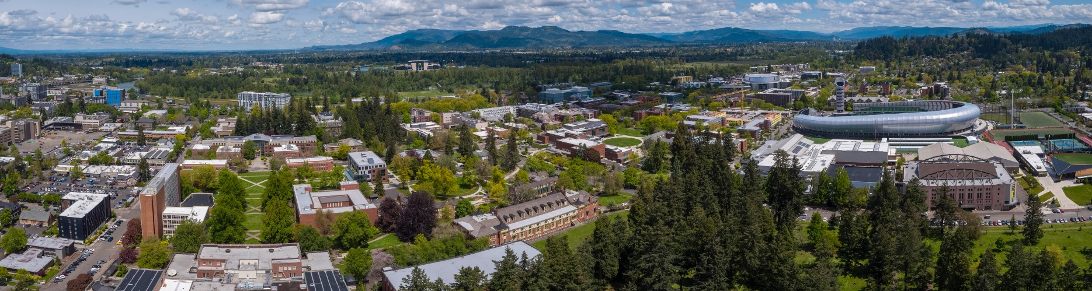
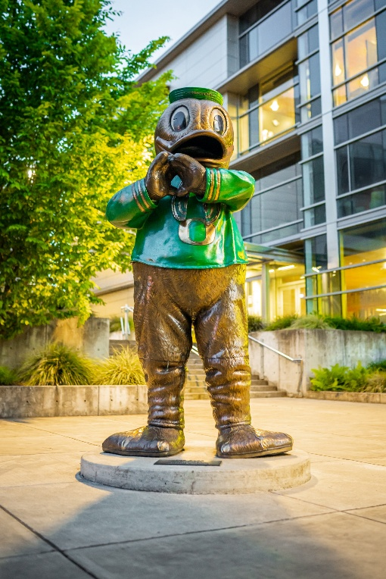
FY24 ANNUAL REPORT
Office of Public Records
The Office of Public Records (OPR), a division under the Vice President and General Counsel, responds to requests from members of the public for university records. The office believes the primary purpose of the Oregon Public Records Law is to provide transparency in the workings of public entities. To that end, this annual report will look at the details of records production, challenges faced by the office, and future goals of the office.
.
PUBLIC RECORDS PRODUCTION
In Fiscal Year 2024, the Office of Public Records processed 542 public records requests, a 17 percent increase from the 464 requests processed in Fiscal Year (FY) 2024, and a 106% increase from the requests received when the office was first founded in FY11. Despite this dramatic increase in requests, the office staffing has remained at two FTE.
Ninety-three percent of the requests received were closed by the end of the fiscal year. Of the closed requests, the average completion time was just over six business days on average, which is consistent with years past.
OUR SIGNIFICANT FIGURES
542
REQUESTS PROCESSED
6.55
DAY AVERAGE RESPONSE TIME
74%
NO FEE ASSESSED

Slide 2
REQUESTOR CATEGORIES
The office breaks requestors into six categories: commercial, media, private, education, labor organizations, and legal (figure 1). These categories allow the office to better understand trends in requests and to automatically reduce costs for non-commercial requests through its simple request fee wavier and the fee reduction for media requestors.
Commercial
Commercial requestors largely represented groups seeking to do business with the University through the RFP/RFQ process, or businesses seeking student directory information.
Media
The office breaks the media into two sub-categories, the news media and student media. In years past the number of requests by the news media and student media have been nearly equal. However, starting in 2020, student media have made significantly fewer requests than the news media. That trend changed this fiscal year, when the Student Media made 30 requests – three times the number of requests they made in FY2023.
Private
Requestors in the Private category made 81 requests, comprising 15% of total requests. As might be expected from unaffiliated requestors, requests in this category touched on many different areas of the University, including Athletics (11 requests), the Office of the Registrar (eight requests), the Office of the President (five requests). Several private requestors also mirrored requests that had been made by others, with 25 requests being fulfilled by the Office with records it already possessed..
Other
The office received 24 requests from Educational organizations, requestors from Labor organizations made 11 requests, and nine requests were made by those in the Legal field.
Figure 1
publicrecords.uoregon.edu
541-346-6823

Slide 3
FEES
The office continues its practice of waiving costs to respond to simple requests, defined as “requests made by non-commercial entities that clearly require less than one hour of university staff time to fulfill.” Seventy-five percent of the requests received in FY24 were fulfilled at no cost to the requestor under this practice. (figure 2)
In total, the office received payment for 56 requests, totaling $8,164.65.
Figure 2
As in years past, the requestor category that was most likely to be charged for requests was the commercial category, with 70 requests resulting in a charge for the response, though only 39 requests were ultimately paid for. The average cost of responding to these requests was $127.39. Of the 139 requests that did not result in a fee estimate, 50 requests were made for records that were exempt from disclosure in their entirety (largely because they were submitted for an RFP/RFQ process that was not yet complete), or for records that did not exist. Thirty-one requests were made for records already possessed by the office, and 27 requests were either abandoned or withdrawn by the requestors. The remaining 31 requests were fulfilled at no cost to the requestor because the requests were for records that were either publicly available or took so little time to fulfill that charging was logistically unsound.
The media were the next most likely to be assessed a fee, with 64 requests resulting in a charge for the response, nine of which were from student media. Six of these requests were ultimately paid for, resulting in an average payment received of $169.69.
One hundred nine requests made by the media were fulfilled under the office’s simple request fee waiver. There were no records responsive to 44 requests, and the remaining 22 requests were either withdrawn by the requestor or abandoned after the office sought clarification of the request.
Private requestors, seeking records for personal use, received estimates to respond to 17 of their requests, one of which was ultimately pursued. The amount paid was $47.92. For the remaining requests: 37 were fulfilled at no cost to the requestor under the office’s simple request fee waiver, 12 requests had no responsive records, 13 were abandoned, and two were referred to other departments.
publicrecords.uoregon.edu
541-346-6823

Slide 4
COMPLIANCE
Of the 542 requests received in FY24, the office processed 38 requests beyond the default statutory completion date of fifteen business days to complete. These cases comprised seven percent of the public records requests handled by the office during the fiscal year. A fee was charged for 13 of these requests, with an average payment of $283.60. Fourteen of the requests that required over fifteen business days to complete were made by the News Media, and four were made by Student Media. Nearly all the requests were complex requests for emails and other correspondence. The office also received eight highly complex requests made by a law firm, six of which carried over into FY25. All these requests required over 15 business days to complete, due to the complex and sensitive nature of the records. In all cases, a reasonable estimated date was provided to the requester, and thus the office finished the year with 100 percent compliance with the deadlines imposed by the Oregon Public Records Law.
TIMELINESS
The metric the office tracks most closely is the time between receiving a request (or a clarification of that request), or the time from when requested payment is made, until the day the requested records are transmitted (figure 3). During FY24, the office had nine requests that fell significantly outside its usual processing times. As mentioned above, eight of these requests were from a law firm seeking records related to the work of faculty in the University’s School of Law and Department of Earth Sciences, and one was from an organization seeking records sent to or from an employee in the Division of Equity and Inclusion related to their work in diversity, equity, and inclusion. All nine requests were extraordinarily expansive in scope and required significant communication with the requestors. Six of the eight requests from the law firm timed out for lack of communication nearly a full year after the requests were made; two were withdrawn by the requestor six months after they were received. Of the six requests that were considered abandoned, all were re-made in the new fiscal year.
The request by the organization seeking Equity and Inclusion materials has remained ongoing, as the requestor consistently communicates needed clarifying information shortly before the 60-day window closes, after which the request would otherwise be deemed abandoned.
These outliers notwithstanding, the office completed 22 of the remaining 29 requests that required more than 15 business days to respond to within a week of the original due date. The other seven requests were completed within two weeks of the original due date.
Figure 3
publicrecords.uoregon.edu
541-346-6823

Slide 5
TRANSPARENCY
The office believes the primary purpose of the Oregon Public Records Law is to provide transparency in the workings of public entities. The office strives to balance this transparency with the need to protect certain types of information submitted to public bodies, including student records, private information, personnel records, faculty research, and trade secrets. In FY23, 204 requests had records provided to requestors without redactions, 93 were provided with some redactions, 26 were denied in full, 47 had no responsive records, three were referred, and 83 were closed for other reasons, mostly due to being abandoned by the requester. (figure 4)
Figure 4
publicrecords.uoregon.edu
541-346-6823

Slide 6
RESPONDING DEPARTMENTS
Consistent with past years, the Athletics Department received the plurality of public records requests, with 33 percent of the total. Three other departments on campus also received a high concentration of requests: Purchasing and Contracting Services received 13 percent, Capital Construction received six percent, and the Office of the Registrar received five percent of the total public records requests. (figure 5)
The remaining requests were distributed relatively evenly across the University, with concentrations in the Office of the President, the School of Law, Human Resources, Office of the General Counsel, and the Office of Investigations and Civil Rights Compliance.
Figure 5
CHALLENGES
FY24 saw the highest number of requests made in the history of the office, while staffing for the office remained consistent at two FTE. As with previous fiscal years, this increase in requests has led to an increase in the average time required to respond to requests, and an increase in the number of requests that require more than 15 business days for a response. This fiscal year the office had the most requests that required over 15 business days to complete, and the longest average response times since FY19. This year, the office also received the highest number of complex requests ever. The office notes that these complex requests have required intensive email searches, for which it does not have the appropriate technology. The office has been able to hire an outside company to perform searches for these requests. However, these requests incur higher costs due to the necessity of paying the outside company to search and host the responsive records.
publicrecords.uoregon.edu
541-346-6823

Slide 7
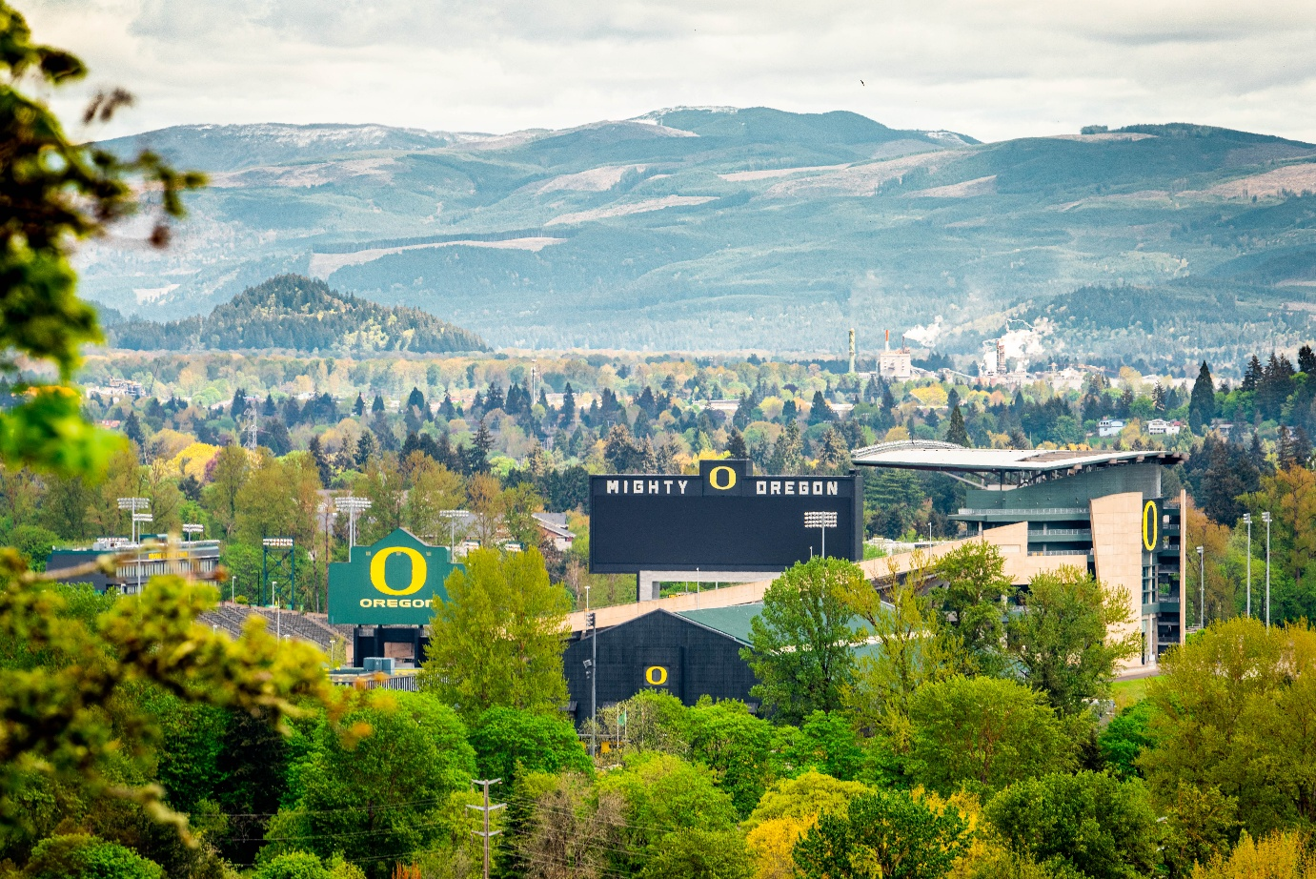
AREAS OF FOCUS IN FY25
The office will host its seventh annual public records roundtable this fiscal year, for public records professionals from municipal governments, K-12 school districts, community colleges and Universities across Oregon and Washington.
The office has also begun the process of creating a working group of public records professionals within the 15 public universities that are fellow members of the Big Ten Academic Alliance. The office has noted through casual networking that the public records offices of these institutions receive many similar requests and face similar challenges. The office hopes that the group can work together to improve processes for all the public BIG10 universities.
The office is looking to improve its training program for campus partners, through in person trainings and the development of on-line reference material. The office is also looking to update its materials for onboarding new University employees.
IN SUMMARY
Fiscal Year 2024 marked a significant milestone for the Office of Public Records, with the highest volume of requests in its history and a notable increase in complexity. Despite staffing and technological constraints, the office maintained its commitment to transparency, timely responses, and legal compliance.
publicrecords.uoregon.edu
541-346-6823

